Slide 1
Opening and Managing
a Casualty’s Airway
LESSON 5

Slide 2
TASK
Open and manage the airway of a simulated casualty.
CONDITIONS
Given a simulated casualty and a combat lifesaver medical equipment set.
STANDARDS
Score a GO on the performance checklists.
Additional injuries to the casualty are prevented.

Slide 3
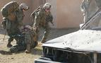
SITUATION
You are treating casualties under direct fire. In your assessment, should you check for breathing and patent airway?

Slide 4
SITUATION
Checking for responsiveness, breathing, and airway is done in Phase 2 of TC3
(Tactical Field Care).

Slide 5
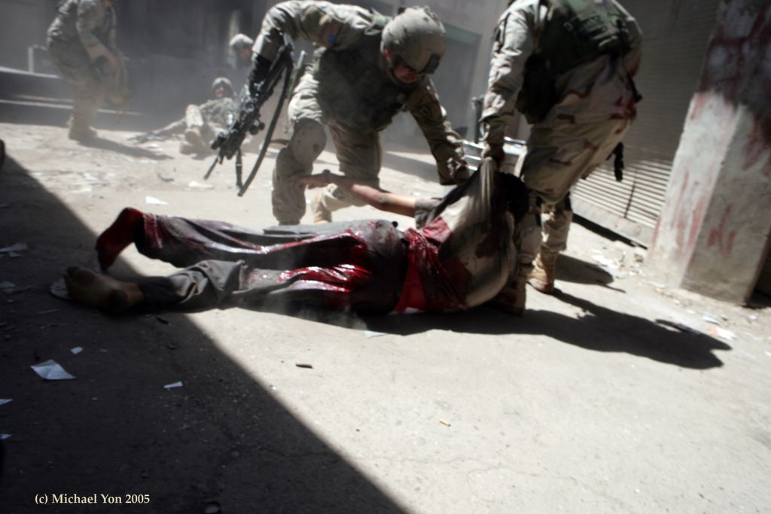
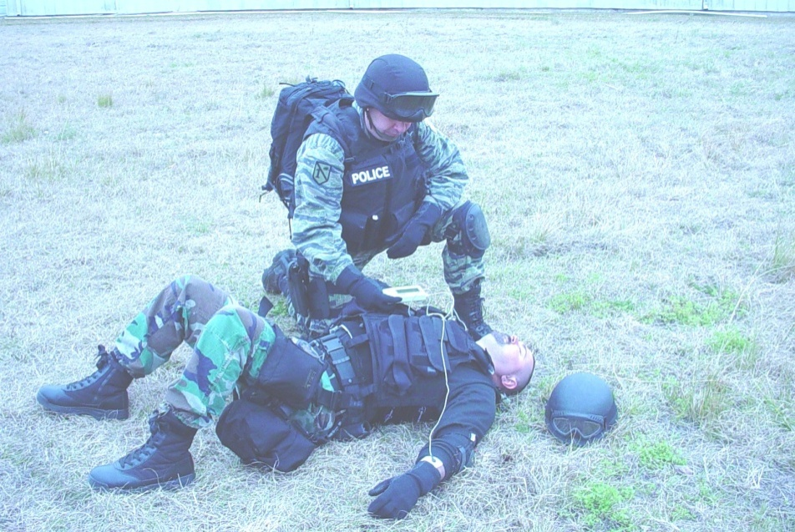
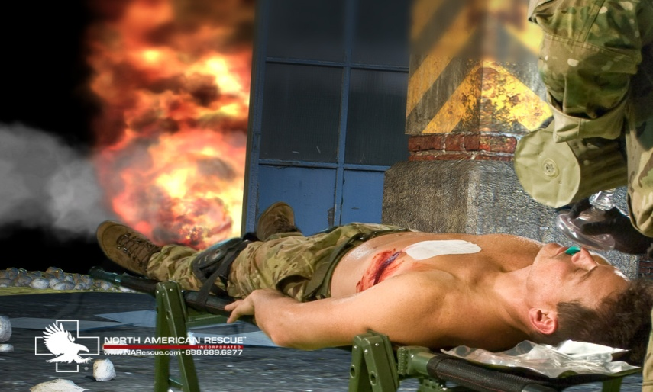
SITUATION
Move to safety.
Position the casualty.
Check for responsiveness

Slide 6
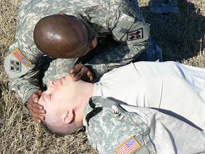
POSITIONING
Open the casualty's
airway using the
head-tilt/chin-lift
method
Look, Listen, and Feel
for 15 seconds

Slide 7
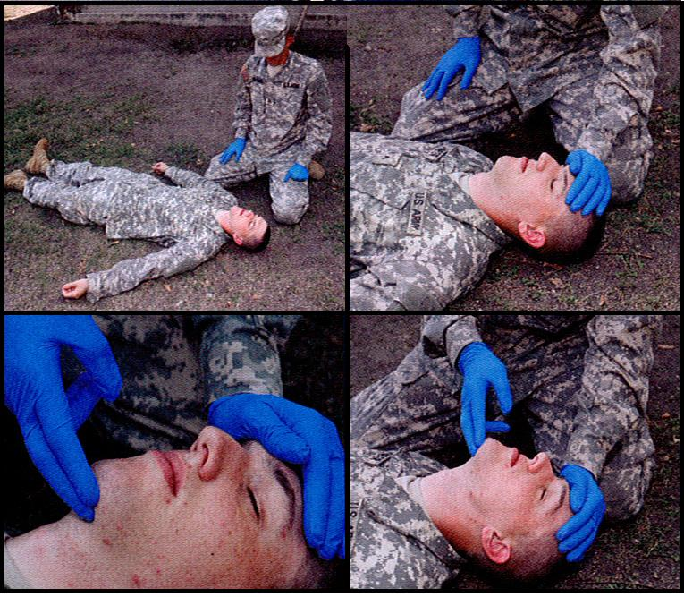
HEAD TILT/ CHIN LIFT
REMEMBER GLOVES!
Kneel beside
casualty’s head.
Place one hand
on the forehead.
2 fingers under the
bony part of the chin.
Apply upward and
downward pressure.

Slide 8
RESCUE BREATHING
Check for a carotid pulse
If the casualty is not breathing and has a pulse, perform mouth to mouth
Pinch the nostril
Give a breath (Remember 1-5-1)
Evaluate chest rise and fall

Slide 9
RESCUE BREATHING
NOTE:
Rescue breathing is only appropriate if you have no other casualties.
Do not perform rescue breathing if casualty has no pulse.
CPR is not recommended and is not a CLS task.
If the casualty resumes breathing on their own, insert an NPA.

Slide 10
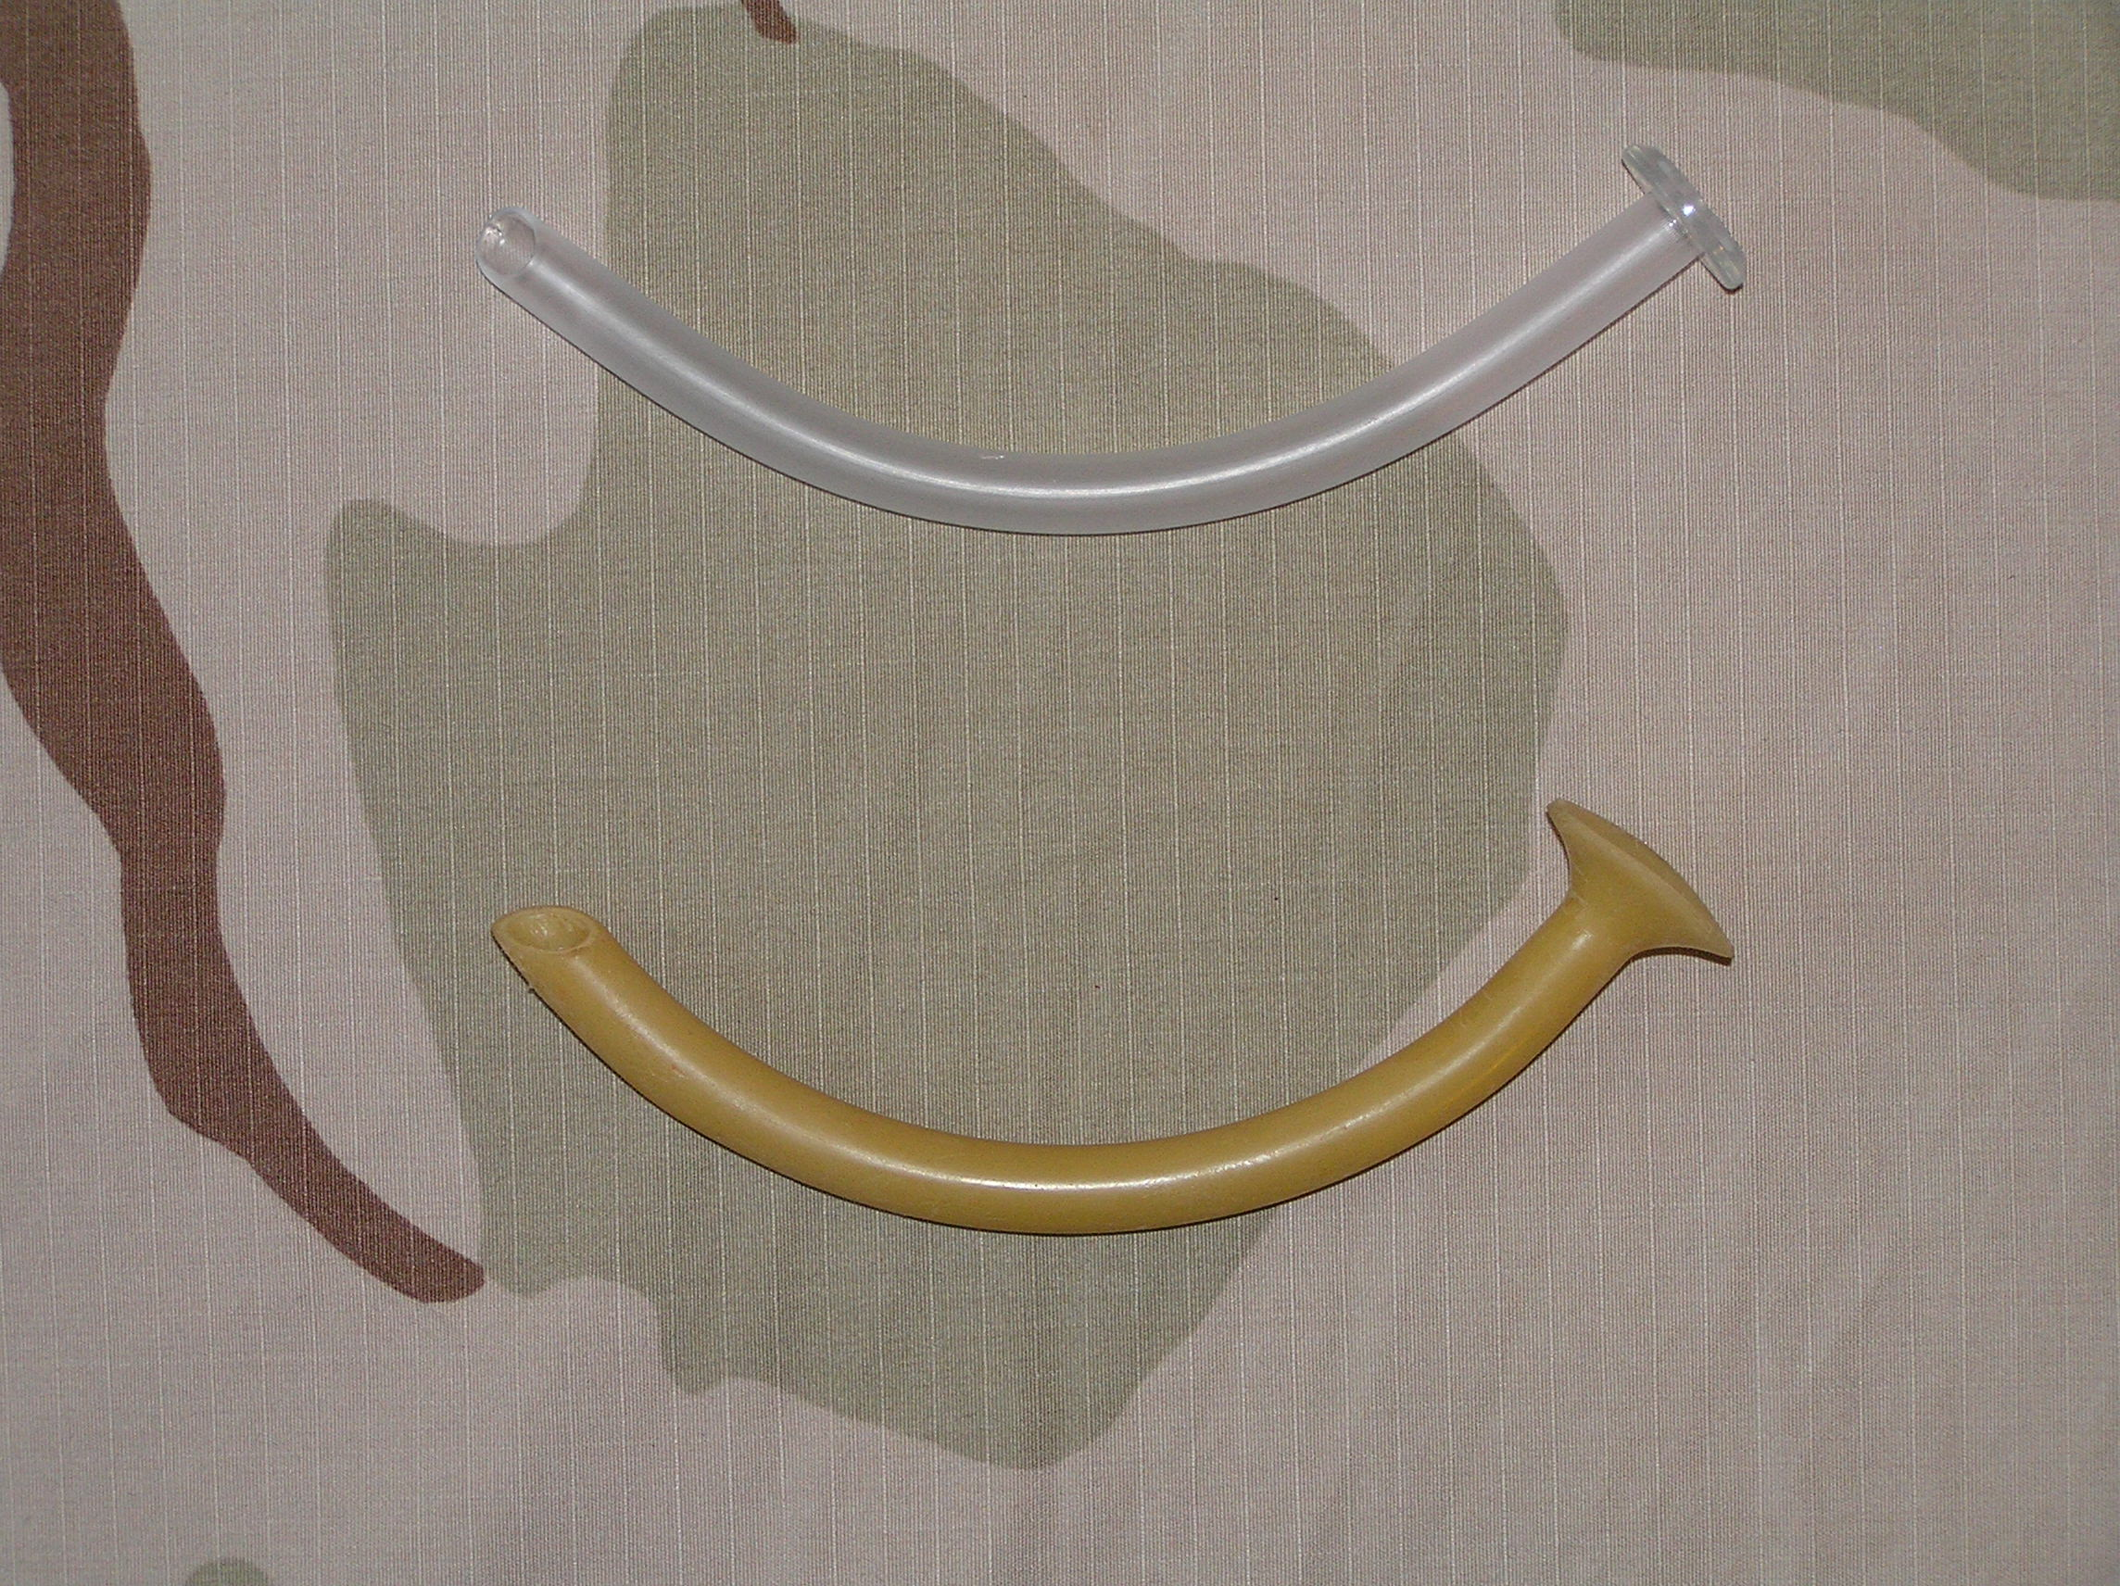
NASOPHARYNGEAL AIRWAY
Flange
Flange

Slide 11
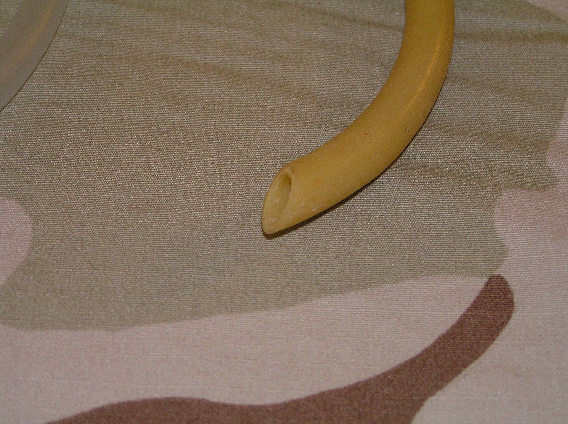
NASOPHARYNGEAL AIRWAY
Bevel
Tip

Slide 12
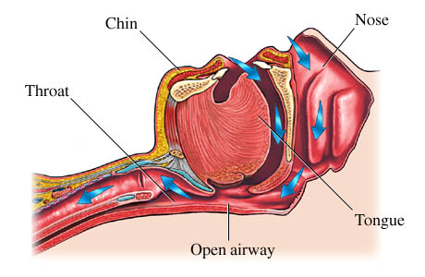
AIRWAY

Slide 13
Nasopharyngeal Airway
It is used to maintain an airway, but will not restore a patent airway to a casualty who is not breathing.
Indications
Snoring/Gurgling
Less than two breaths every 15 seconds
Unconscious
**However, the NPA can be given to casualties who are conscious and semi-conscious

Slide 14
Nasopharyngeal Airway
Do not use the NPA if…
Evidence of head and facial trauma including,
the roof of the casualty's mouth is fractured.
brain matter is exposed.
clear fluid is coming from the nose or ears.
Cleft lip or cleft palate.

Slide 15
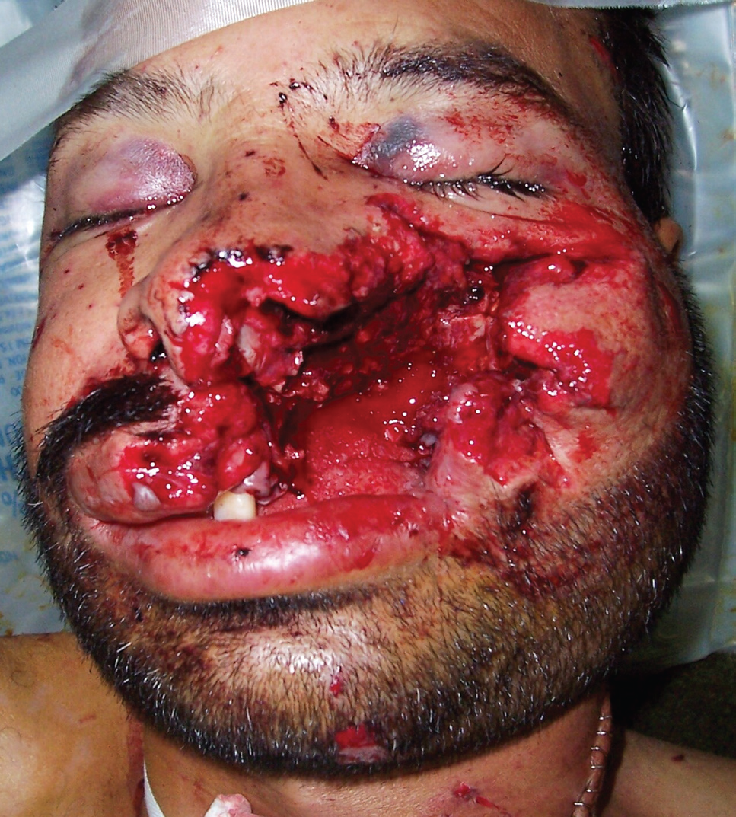
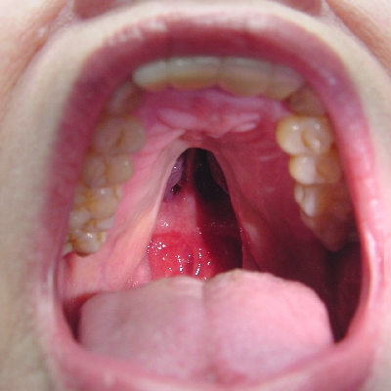
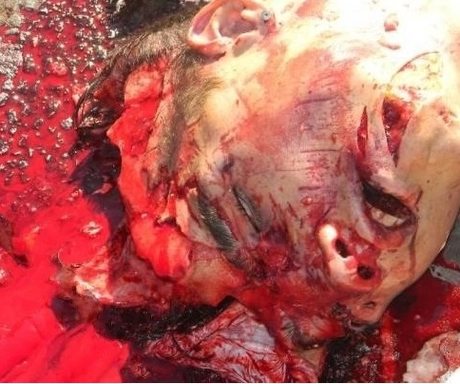
Nasopharyngeal Airway
Facial Trauma
Cleft Palate
Exposed Brain Matter

Slide 16
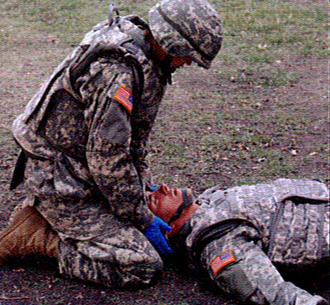
Inserting the Nasopharyngeal Airway
Place the casualty on his back (face up)

Slide 17
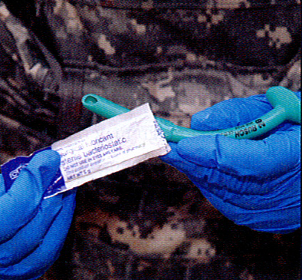
Inserting the Nasopharyngeal Airway
Remove NPA and lubricant from aid bag
Lubricate the tube

Slide 18
Inserting the Nasopharyngeal Airway
EXPOSE THE CASUALTY’S NOSTRIL
Bevel toward septum
Pig Nose
Right nostril

Slide 19
Nasopharyngeal Airway
Advance until flange rests against the nostril
Tape in place
DO NOT COVER THE OPENING

Slide 20
Nasopharyngeal Airway
CAUTION:
DO NOT FORCE THE NPA
If there is resistance or blockage, use the other nostril.
If both attempts fail, position the casualty in the recovery position and seek medical help.
If the NPA is the only intervention, roll the casualty onto the side opposite the NPA.

Slide 21
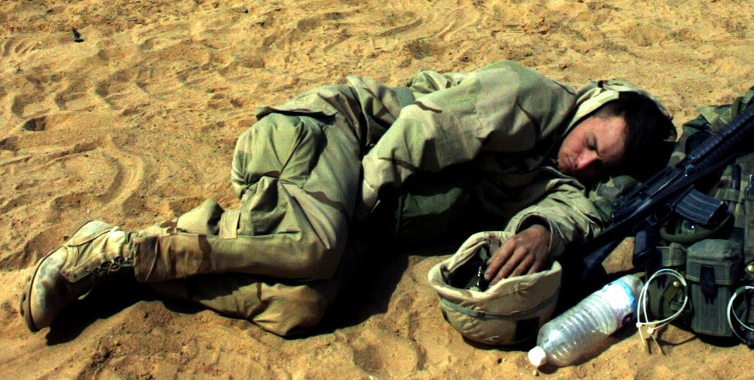
PLACING THE CASUALTY IN A RECOVERY POSITION
Roll the casualty as a single unit onto his
side.
Place the hand of the casualty’s lower arm
under his chin.
Flex the casualty’s upper leg.

Slide 22
Questions?

